Slide 1

COMP821
Blockchains and blockchain security

Slide 2
A purely peer-to-peer version of electronic cash would allow online payments to be sent directly from one party to another without going through a financial institution. Digital signatures provide part of the solution, but the main benefits are lost if a trusted third party is still required to prevent double-spending. We propose a solution to the double-spending problem using a peer-to-peer network. The network timestamps transactions by hashing them into an ongoing chain of hash-based proof-of-work, forming a record that cannot be changed without redoing the proof-of-work. The longest chain not only serves as proof of the sequence of events witnessed, but proof that it came from the largest pool of CPU power. As long as a majority of CPU power is controlled by nodes that are not cooperating to attack the network, they'll generate the longest chain and outpace attackers. The network itself requires minimal structure. Messages are broadcast on a best effort basis, and nodes can leave and rejoin the network at will, accepting the longest proof-of-work chain as proof of what happened while they were gone. (Nakamoto, 2008)
https://bitcoin.org/bitcoin.pdf Satoshi Nakamoto (2008)
Bitcoin: A Peer-to-Peer Electronic Cash System

Slide 3
What is it?
Blockchain Technology (BCT) solves the problem of transfer of value between Internet users without having to rely on a third party
Bitcoin is currently the best known application of BCT. It is one of many digital currencies using BCT.
Why digital currency is used?
No need to use a central exchange (e.g., banks) for people who know/use Bitcoin u
Direct exchange between individuals is possible
Many more uses for BCT technology other than “currency” !

Slide 4
Security and privacy in BCT (Zhang, et al., 2019)
1: “…as blockchain technology ....[is]to be deployed in various applications, it is critical to gain an in-depth understanding of the security and privacy properties of blockchain and the degree of trust that blockchain may provide. “
2: “Such understanding may shed light on the root causes of vulnerabilities in current blockchain deployment models and provide foresight and technological innovation on robust defense techniques and countermeasures.”

Slide 5
(Zhang et al. 2019)
What is Blockchain?
A distributed public ledger.
Records and verifies all crypto currency (e.g., Bitcoin) transactions on the open, decentralized, peer-to-peer networked system for this cryptocurrency
Capable of preventing double spending
Transaction records are organized as a hierarchically expanding chain of blocks . Each block guarded by cryptography techniques to enforce strong integrity of its transaction records.
New blocks can only be committed into the global blockchain upon a successful completion of the decentralized consensus procedure (e.g., PoW – proof of work).
Notes:
Investopedia : ….is ….a decentralized consensus mechanism that requires members of a network to expend effort solving an arbitrary mathematical puzzle to prevent anybody from gaming the system. Proof of work is used widely in cryptocurrency mining, for validating transactions and mining new tokens.

Slide 6
Collaborative, peer-to-peer network, secured by cryptography and proof-of-work (PoW)
The distributed ledger replaces the centrally managed ledger.
All transactions within a block are recorded and visible. Full transparency for every transaction can be achieved
And can never be changed (“Immutable”).
Public, private, hybrid blockchains: read about private and public cryptocurrencies here https://www.nasdaq.com/article/know-your-coins-public-vs-private-cryptocurrencies-cm849588
Public (e.g., bitcoin) protect anonymity (not privacy), transactions fully traceable.
Private (e.g., particl) aim to protect privacy and make transactions untraceable .

Slide 7
Transactions involving a cryptocurrency (e.g., Bitcoin)
A network of “miners”, ordinary users, and currency exchanges (where the cryptocurrency is traded against other currencies). All nodes have a Public key available to other nodes, and a private key.
The starting block is created by a miner. Specialised software for mining. Objective: to create a hash (used as a block ID) that meets certain “difficulty“ conditions, for example a hash starting with 0000. Calibrated periodically to maintain the level of difficulty. The block header contains a variable part, a “nonce” that can be changed till the resulting hash meets the condition.
Miners calculate the hash (compete to do so) for a transaction(S) created by other users, and make them into a block. All miners verify the block then add it to the blockchain copy they have.
Miners earn a transaction fee. May earn a subsidy , i.e., some fixed amount of the cryptocurrency

Slide 8
Using blockchain without cryptocurrency
Data privacy protection
Supply chain
Other: government, banks, insurers, utility companies, rental industry, property sales, notarised transactions
Ethereum , smart contract
Hyperledger

Slide 9
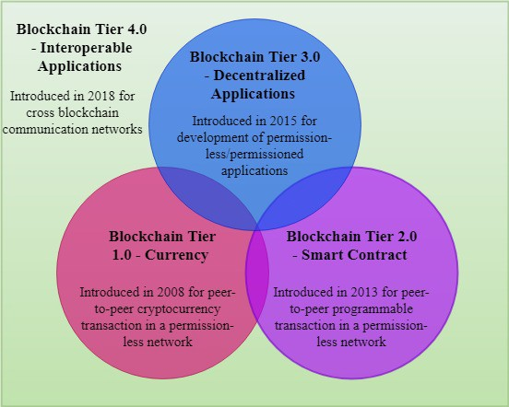
(Ismail et al, 2019) Blockchain tiers
In tiers 1,2,3 – single ledger architecture
In tier 4- multi ledger architecture for private blockchain architecture , computationally heavier
See this slide notes for more details
Notes:
Single-ledger-based blockchain architecture for a public network can be used for application domains that do not require private transactions and authentication for the users to join the network, whereas the architecture for private network should be used to build a blockchain within a trusted domain, i.e., an organization or a federation of organizations.
The architecture for a hybrid network should be used by the public applications requiring confidential transactions between a subset of network participants. In a public or a hybrid network, anyone can be a full node and/or a mining one. With more nodes participating as full and/or mining ones, the number of messages transfers increases in the network, limiting the blockchain scalability. Comparing the number of encryption/decryption operations in a transaction flow, the private network has fewer operations than the public one thanks to its defined access control to the blockchain.
Both public and private architectures store all the transactions data in clear in the ledger. However, the hybrid architecture has less encryption/decryption operations than the public and private because the nodes which are not involved in a private transaction store only the transaction hash. The encryption/decryption operations are computationally complex and energy-hungry
The multi-ledger-based architecture can be used in application domains that involve several collaborating organizations which require confidentiality of transactions among different subgroups. For example, collaborating universities, banks or hospitals. (This architecture is implemented by Oracle).
Compared to the single-ledger-based hybrid architecture that also enables confidential transactions, the multi-ledger architecture requires more encryption/decryption operations. This is because in a hybrid network the encryption/decryption operations are only performed by the nodes involved in a transaction, whereas in the multi-ledger architecture all the endorsing and committing peers perform the encryption/decryption operations.

Slide 10
BASICS
The blockchain is a distributed database. Replicated on “all” participant nodes (computers, hosts) . The blockchain consists of a chain of blocks, where every block contains data (for instance a financial transaction, record, a file, or a personal data record).
Bitcoin blockchain: over 190 GB in 2019, over 317 GB in February 2021 . https://www.statista.com/statistics/647523/worldwide-bitcoin-blockchain-size/
When a new block (e.g., a record of a new transaction) is to be added to the chain, it has to be verified by the network of nodes first, and once this is done, the transaction record can be inserted in the blockchain.
The mining and the consensus protocols govern this phase
It is impossible to modify the data stored in the blockchain.
The blocks are connected with each other in a way that if a node wants to edit the content of one block it will be necessary to edit all following blocks, moreover for to edit a block, the consensus of other nodes will be needed.
Hence the more people are using a blockchain, the longer it is and the more secure the system is.
The blockchain is a distributed ledger that can be used in different scenarios
….possible although very difficult to break in it.
There are already distributed ledgers that have no blocks, e.g., IOTA (for the IoT) (“entangled transactions” instead

Slide 11
Techniques used in BCT (Zhang et al, 2019)
A suite of popular security techniques:(1) hash chain, (2) Merkle tree, (3) digital signature plus (4) consensus mechanism to ensure
(1)no double spending, and
(2) no retrospective transaction change.
Merkle tree : a type of a binary search tree, allows quickly to verify membership to a list.
Used for the transactions in one block, as a block typically contains multiple transactions

Slide 12
An example of Hash chain: A hash pointer used to create a hash chain
Possible to make changes?
Change Felix to Florence in Block 2
Modify chain forward
1. Calculate H2new= hash (H1\Florence)
2. As H2 and H2new are not the same → need to change H2 in Block 3 to H2new…..
……Hard to change all blocks following as new ones will be coming ; also because in BC, multiple identical copies of the validated blocks are stored .
“This is the zero block – a record about a cat named Tom”
Content: catTom
Hash: H0 = (hash of catTom)
“This is block 1 – a record about a dog named Gonzo”
Content: H0|dogGonzo
Hash: H1 = hash(H0|dogGonzo)
Modify chain backward:
1. Find H1new such that hash(H1new|catFlorence) = H2
2. Replace H1 with H1new in block2 and in block 1
3. Find H0new such that hash (H0new|dogGonzo) = H1new
4. Replace H0 with H0new In Block1. Cannot replace H0 with H0new as H0 is known and if replaced this will be discovered. Block 0 is the “genesis” block and cannot be changed
“This is the block 2 - a record about a cat named Felix”
Content: H1|catFelix
Hash: H2 = hash (H1|catFelix)
“This is block 3 - a record about a cat named Arthur”
Content: H2|catArthur
Hash: H3 =hash (H2IcatArthur)

Slide 13
If an adversary tries to tamper with data at a leaf node, it will cause a change in the hash value of its parent node; even if he/she continues to tamper with the upper node, he/she needs to change all nodes on the path of the bottom to the top.
https://bitzuma.com/posts/how-bitcoin-works/ is an excellent source to start reading about bitcoin

Slide 14
Detecting that data have been tampered with: if the computed hash pointer of root node does not match with the hash pointer that has been stored.

Slide 15
Digital signature
Digital signature: Bitcoin uses ECDSA (Elliptic Curve Digital Signature Algorithm) as its digital signature scheme for signing transactions.
Key pairs are generated by users themselves; users can generate multiple key pairs—as many as they want.
Use of wallet and public key encryption and an ‘address’. Wallet: Explained in brief https://www.youtube.com/watch?v=GSTiKjnBaes
See also https://www.science.org.au/curious/video/public-private-keys
Bitcoin: User selects a “seed phrase ” → system generates user’s private key(s) and user’s public key(s)→ system generates user’s address (s) (a shorter version of the public key)

Slide 16
Consensus
Every message transmitted between the nodes has to be approved by a majority of participants of the network through a consensus-based agreement. The shared public ledger needs an efficient and secure consensus algorithm, which must be fault tolerant, and ensure that:
(i) all nodes simultaneously maintain an identical chain of blocks
(ii) there is no need for a central authority to keep malicious adversaries from disrupting the coordination process of reaching consensus.
(iii) the network is resilient to partial failures and “attacks,” such as when a group of nodes are malicious or when a message in transit is corrupted.
Important consensus method properties: persistence and liveness.
Persistence guarantees the consistent response from the system regarding the state of a transaction. For example, if one node on the network states that a transaction is in the “stable” state, then the other nodes on the network should also report it as stable, if queried and responded to honestly.
Liveness states that all nodes or processes eventually agree on a decision or a value. It may take a sufficient amount of time for reaching the agreement.
The combination of persistence and liveness ensures that transaction ledger is robust: only authentic transactions are approved and become permanent.
For a comprehensive overview, of consensus protocols see section 5 of Ismail et al., 2019

Slide 17
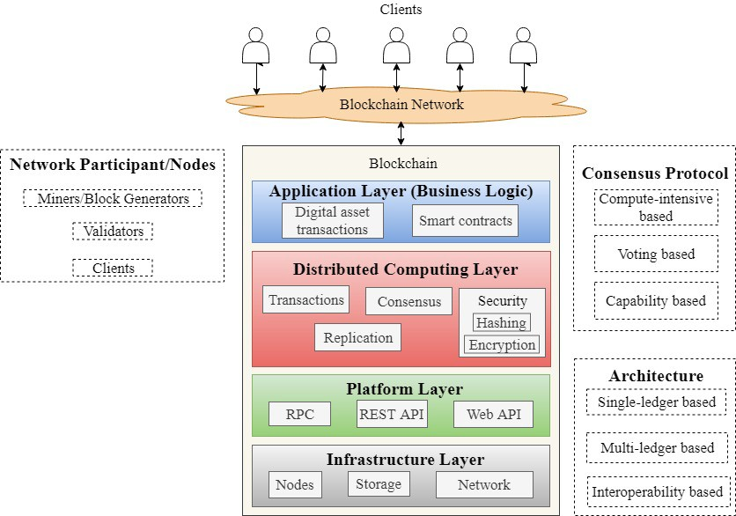
The architecture of Blockchain (Ismail et al. 2019)
Client node: can send/ receive transactions
Full node : send/receive transactions, store a copy of the ledger, validate transactions
Mining node: a full node with the capability of mining, i.e., the process of generating a new block.
The distributed computing layer ensures local access to data, fault tolerance, immutability, privacy, authenticity, and security for the transaction data
See slide notes for a summary of BC architecture properties
Notes:
Properties
Decentralization: Transactions processed and validated by the consensus of most network nodes and replicated on the nodes in a ledger. This eliminates the need for an intermediary to share and maintain the transaction data
Immutability: The transactions in blockchain are stored into blocks. Each block in the chain is linked to the previous block using a cryptographic hash function. Any attempt to modify the content of a block will affect the subsequent blocks in the chain. Consequently, a malicious attacker needs to change all the succeeding blocks in the chain to modify a particular block, which is computationally difficult because the chained blocks are replicated over multiple nodes.
Transparency: The ledger is only updated when most of the nodes reach a consensus. Changes in the network are publicly visible ensuring transparency and security.
Traceability: The distributed and transparent nature of blockchain makes it easier to trace any transaction event. Each update in the state of an asset can be traced down back to its origin. This helps in making the network more secure, efficient and transparent.
Trustless: Blockchain allows transaction of assets between unknown parties who do not trust each other. By distributing the ledger across several nodes in the network and updating this ledger via a consensus ensures the validity of transactions in an untrusted environment.

Slide 18
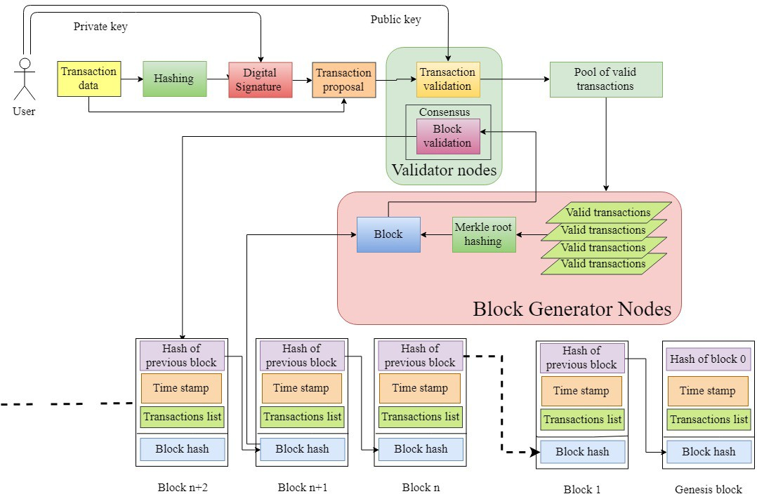
Transaction flow (Ismail et al. 2019)
See slide notes for definitions
Notes:
Definitions
Transaction: A process that changes the state of the blockchain ledger. Depending on the application, the transaction can be the transfer of a financial value or the execution of a smart contract.
Block: It consists of a block header and block data. The header consists of the block metadata information such as the Merkle tree root hash, the previous block hash, the timestamp, and the block version, whereas the data consists of a set of valid transactions
Merkle tree root hash: All the transactions in the block are hashed individually by using a hashing algorithm. The hash values are then combined pairwise and are hashed again until a single hash value is obtained. This value is known as the Merkle tree root hash value.
Block hash: It is the unique identifier of a particular block and is obtained by hashing the block header twice
Previous block hash: It is the hash of the block preceding the current block in the chain. The preceding block is known as the parent of the current block. The use of the previous block hash value in a block header is to ensure the immutability of the blockchain ledger.
Timestamp: It indicates the time at which the block is created.
Block version: It indicates the version of the blockchain protocols used.
Mining: It is the process of adding the valid transactions in a block and broadcasting that block to the network.
Genesis Block: This is the first block in the ledger. All the following blocks in the chain are linked to the genesis block. The genesis block generally includes the configuration for the network characteristics, the consensus protocol to be used, the access-control rights, the hash function, the block generation interval, and the block size.

Slide 19

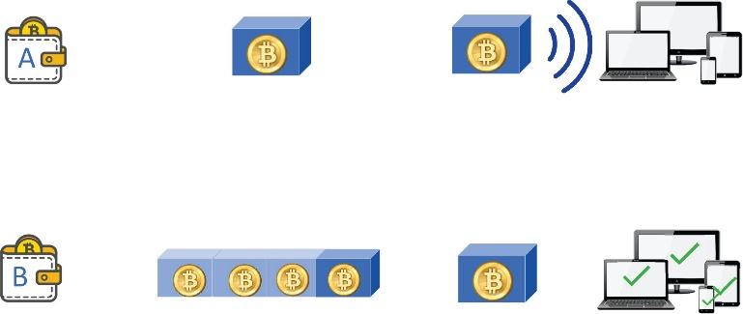



Example, Bitcoin (Zhang et al. 2019)
A wants to send bitcoin to B
How does A send money to B?

Slide 20
Issues with BCT and BCT applications (Ismail et al, 2019)
1. “Originally developed to transfer digital currency without relying on intermediaries… blockchain has evolved to serve decentralized applications.” …has given rise to collaborative ecosystems…but the underlying BC architecture consumes enormous amounts of energy. … In 2017, the Bitcoin mining used around 30.14 TeraWatt hours (TWh) of energy, which is equivalent to the energy usage of entire Ireland in a year. …. The annual carbon dioxide emissions by the Bitcoin network are as high as 22.9 million metric tons, almost equivalent to the amount produced by countries such as Sri Lanka and Jordan…
Further challenges:
2. Trust and transparency between the customers and service providers are required .
3. Customers benefit from eliminating intermediaries to reduce the transaction cost. However….there is a significant data communication overhead with increasing number of network participants ….this may hinder the quality of services of the developed applications.
Addressing the problems of energy consumption and scalability often trades off with security and privacy

Slide 21
(Zhang et al, 2019) Issues with BCT - Consistency, Availability and Partition Tolerance
The CAP theorem: any distributed system can have only two of the following properties]: — Consistency: where each computing node receives the most recent write. — Availability: where any data are always available on request.— Partition tolerance: where the distributed system is always operational, even when some subset of nodes fail to operate.
CAP Properties in Distributed Ledger—The Problems. In the context of a distributed ledger, CAP properties mean—(1) Consistency: all nodes keep an identical ledger with most recent up- dates. (2) Availability: any transactions generated at any time in the network will be able to be accepted in the ledger. (3) Partition tolerance: even if part of the nodes fail, the network can still operate normally.
The main issue is that it is hard for any widely acceptable currency to exist without all three CAP conditions being met. No one will use a currency if the system is not available when the transaction is initiated or some transactions are not recognized by the system (a C-P system). No one will use a currency where if any one node fails, the system will not operate normally (CA- system). No one will use a currency if the ledgers saved by different nodes in a distributed ledger system are inconsistent (an -AP system).

Slide 22
(Zhang et al., 2019) Security and Privacy Requirements of Online Transactions, and Blockchain properties (1)
Consistency of the Ledger across different financial Institutions. For Bitcoin, blockchain implements the partition tolerance (P) while supporting consistency (C) and availability (A) on the clipped blockchain with the most recent ω blocks disregarded
Integrity of Transactions. For Bitcoin , if a miner attempts to tamper with the information of the received transaction→ Miner cannot change payee address, let us say, to herself, as each transaction is digitally signed. Since the transaction is sent to the entire network for approval, a discrepancy will be discovered, discovered ; OR an adversary may attempt to tamper with the information stored on the blockchain→ the hash chain prevents this. Plus, every node has a copy, hard to modify them all
Availability of System and Data. The users of online systems should be able to access the data of transactions at any time, anywhere. The availability here refers to both system level and transaction level. At the system level, the system should run reliably even in the event of a network attack. At the transaction level, the data of transactions can be accessed by authorized users without being unattainable, inconsistent, or corrupted.
For Bitcoin: Resistant to DDoS , as it is fully decentralized in terms of construction and maintenance, and uses a consensus protocol for new block generation and addition to the blockchain. These ensure that the processing of blockchain transactions can continue even if several blockchain nodes go offline. In order for a cyber-attacker to succeed in making blockchain offline, the attacker would have to collect sufficient computational resources that can compromise overwhelmingly large portions of the blockchain nodes across the entire Bitcoin. The larger the Bitcoin network becomes, the harder it is to succeed in such large-scale DDoS attack.
Prevention of Double-Spending..To prevent double-spending, Bitcoin evaluates and verifies the authenticity of each transaction using the transaction logs in its blockchain with a consensus protocol. By ensuring all transactions be included in the blockchain, the consensus protocol allows everyone to publicly verify the transactions in a block before committing the block into the global blockchain, ensuring that the sender of each transaction only spends the bitcoins that he possesses legitimately. In addition, every transaction is signed by its sender using a secure digital signature algorithm. It ensures that if someone falsifies the transaction, the verifier can easily detect it. The combination of transactions signed with digital signatures and public verification of transactions with a majority consensus guarantees that Bitcoin blockchain can be resistant to the double-spending attack.

Slide 23
(Zhang et al 2019) Security and Privacy Requirements of Online Transactions, and Blockchain properties (2)
And In Bitcoin: Resistance to the Majority (51%) Consensus Attack? . This attack refers to the risks of cheating in the consensus protocol. 51% attack, may occur in the presence of malicious miners.
For example, if a miner (verification user) controls more than 50% of the computing power for maintaining the blockchain.
Or, the 51% attack may happen when a group of miners collude to perform a conspiracy, e.g., with respect to counting the miners’ votes for verification. If one powerful user or a group of colluding users controls the blockchain, then various security and privacy attacks may be launched, such as illegally transferring bitcoins to some target wallet(s), reversing genuine transactions as if they were never occurred.
Anonymity of Users’ Identity.
IN Bitcoin: Pseudonymity. Pseudonymity refers to a state of disguised identity. In Bitcoin, addresses in blockchain are hashes of public keys of a node (user) in the network. Users can interact with the system by using their public key hash as their pseudo-identity without revealing their real name. Thus, the address that a user uses can be viewed as a pseudo-identity. We can consider the pseudonymity of a system as a privacy property to protect a user’s real name. In addition, users can generate as many key pairs (multiple addresses) as they want, in a similar way as a person can create multiple bank accounts as she wishes. Although pseudonymity can achieve a weak form of anonymity by means of the public keys, there are still risks of revealing identity information of users.

Slide 24
(Zhang et al, 2019) Security and Privacy Requirements of Online Transactions, and Blockchain properties (3)
Confidentiality of Transactions. ….. minimal disclosure …………..(1) users’ transaction information cannot be accessed by any unauthorized user; (2) the system administrator or the participant of the network cannot disclose any user’s information to others without his or her permission; (3) all user data should be stored and accessed consistently and securely, even under unexpected failures or malicious cyber-attacks. Such confidentiality is desirable in many non-financial scenarios.
In Bitcoin, little confidentiality. In general, confidentiality and privacy pose a major challenge for blockchain and its applications that involve sensitive trans- actions and private data.
Unlinkability of Transactions. …. users should require that the transactions related to themselves cannot be linked.
In Bitcoin: because every trans- action is recorded on the ledger with the addresses of sender and receiver, and is traceable freely by anyone using the associated addresses of its sender and receiver. Thus, anyone can relate a user’s transaction to other transactions involving her accounts by a simple statistical analysis of the addresses used in Bitcoin transactions. For example, by analysis on a sender’s account, one can easily learn the number and total amount of bitcoins coming out or going into this account.
Alternatively, one can link multiple accounts that send/receive transactions from one IP address. More seriously, a user may lose her anonymity and thus privacy for all the transactions associated with her Bitcoin address if the linkage of her bitcoin address to the user’s real-world identity is exposed. In addition, given the open nature of the public blockchain, anyone can attempt to perform this type of de-anonymization attack silently and secretly without having the target user even realizing that she is being attacked or her true identity has been compromised. Therefore, the blockchain implementation in Bitcoin only achieves pseudonymity but not unlinkability and thus not full anonymity defined by pseudonymity with unlinkability

Slide 25
Attacks
51% attack (Investopedia.com) By controlling the majority of the computing power on the network, an attacker or group of attackers can interfere with the process of recording new blocks.
…prevent other miners from completing blocks, theoretically allowing them to monopolize the mining of new blocks and earn all of the rewards
….block other users' transactions. They can send a transaction, then reverse it, making it appear as though they still had the coin they just spent. This vulnerability, known as double-spending, is the digital equivalent of a perfect counterfeit and the basic cryptographic hurdle the blockchain was built to overcome, so a network that allowed for double-spending would quickly suffer a loss of confidence.

Slide 26
(Zhang et al, 2019, , Table 2) Summary of Blockchain Security and Privacy Requirements, Properties, and Techniques

Slide 27
Security issues – Questions for Self-Study
What is Bitcoin? What is a digital wallet?
What is a fork? Are there security issues?
3. What is “immutability”?
For a summary and also breach cases, read Guo and Yu, 2022 (section 5): https://www.sciencedirect.com/science/article/pii/S2096720922000070
Guo, H., & Yu, X. (2022). A survey on blockchain technology and its security. Blockchain: research and applications, 3(2), 100067.

